Slide 1
Neural Machine Translation in Linear Time (ByteNet)
A 2016 paper from DeepMind
Authors:
Nal Kalchbrenner
Lasse Espeholt
Karen Simonyan
Aäron van den Oord
Alex Graves
Koray Kavukcuoglu
Presented by: Johnny

Slide 2
Weaknesses of RNN-based Enc-Dec
RNNs have an inherently serial structure that prevents them from being run in parallel along the sequence length during training and evaluation.
Forward and backward signals in a RNN also need to traverse the full distance of the serial path to reach from one token in the sequence to another.
The larger the distance, the harder it is to learn the dependencies between the tokens [2].
Many processes the source sequence into a constant size representation, burdening the model with a memorization step.

Slide 3
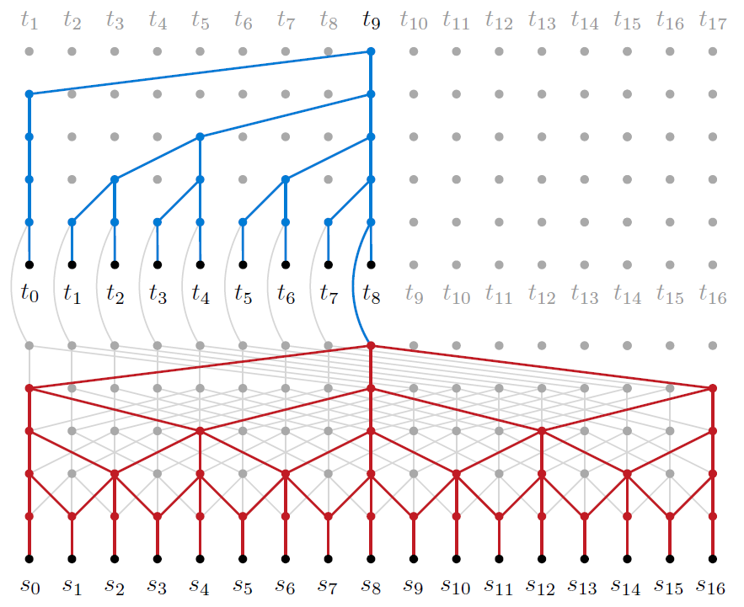
ByteNet
The encoder processes the source string into a representation and is formed of one-dimensional dilated convolutional layers.
The decoder is a language model that is formed of one-dimensional dilated convolutional layers that are masked.
Decoder
Encoder

